Slide 1

OncoAI: Revolutionizing Cancer Care
An AI-driven ecosystem transforming cancer treatment, prediction, and patient support.
By Team BholeChature
Abuzaid – AI/ML
Aditya- Backend
Jiya Jain- Frontend/PPT
Muskaan Bhatia-Frontend/PPT
Dhruv Mohapatra -Backend

Slide 2
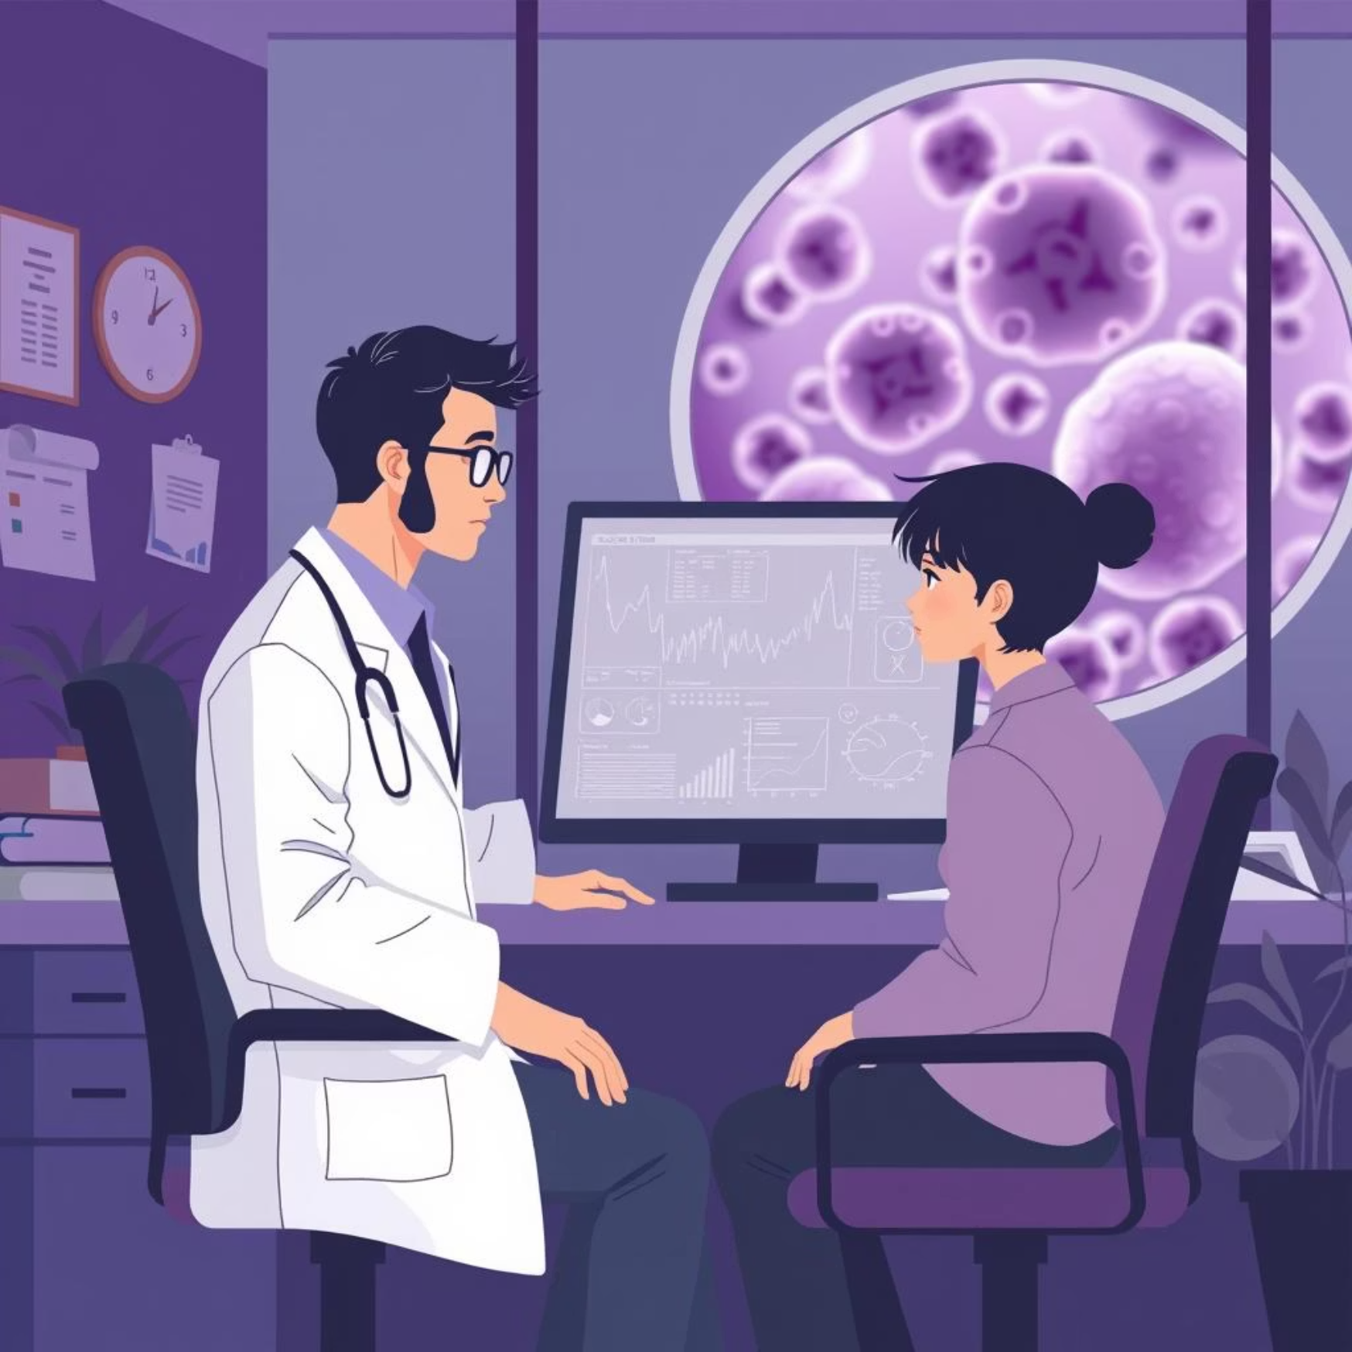




The Unmet Challenges in Oncology
Current cancer care faces significant hurdles:
Suboptimal Treatment
Ineffective trial-and-error approaches lead to suboptimal outcomes.
Late Detection
Delayed metastasis detection limits proactive intervention.
Lack of Personalization
Generic treatments for complex cases lack individual tailoring.
Patient Distress
High anxiety and limited understanding of their care journey.
These challenges result in delayed care, increased side effects, and a fragmented patient experience.

Slide 3




🩺 Proposed Solution – OncoR AI
OncoR AI is an AI-powered oncology assistant designed to bridge the gap between complex cancer data and actionable care.
Core Idea
Build a smart, accessible platform that helps doctors and patients get early insights, personalized treatments, and survivability forecasts.
How It Works
Data Input → Patient profile (age, stage, genomic data, history, symptoms).
AI Engine → Predicts cancer risk, metastasis probability, survivability curves.
Treatment Guidance → Recommends therapies & clinical trials from global guidelines.
Dashboards → Clear, visual reports for doctors (clinical view) and patients (simple view).
Why It’s Unique
Purpose-built oncology models, not just general AI.
Personalized Medicine: Matches treatments to each patient’s unique profile.
Accessible: Runs on lightweight web/mobile apps, deployable in low-resource settings.
Impactful: Supports oncologists, empowers patients, and reduces diagnostic delays.

Slide 4
Objectives & Vision for a Cancer-Free Future
AI-Powered Early Detection & Risk Stratification Develop models that can analyze medical imaging, genomic data, pathology reports, and patient history to detect cancer early and estimate progression risk.
Personalized Treatment Recommendations Use AI to compare a patient’s profile with global clinical trial data, treatment guidelines, and real-world outcomes to recommend the most effective therapies.
Survivability & Prognosis Prediction
Provide probability-based forecasts (1-year, 5-year, 10-year survivability) to support oncologists in shared decision-making with patients.
Equitable Access in Low-Resource Settings
Design the system to run efficiently, with cloud-based AI + lightweight mobile/web interfaces, so it can be deployed even in rural/low-infrastructure hospitals.
OncoAI aims to redefine cancer care: personalized, predictive, and patient-centric globally.

Slide 5
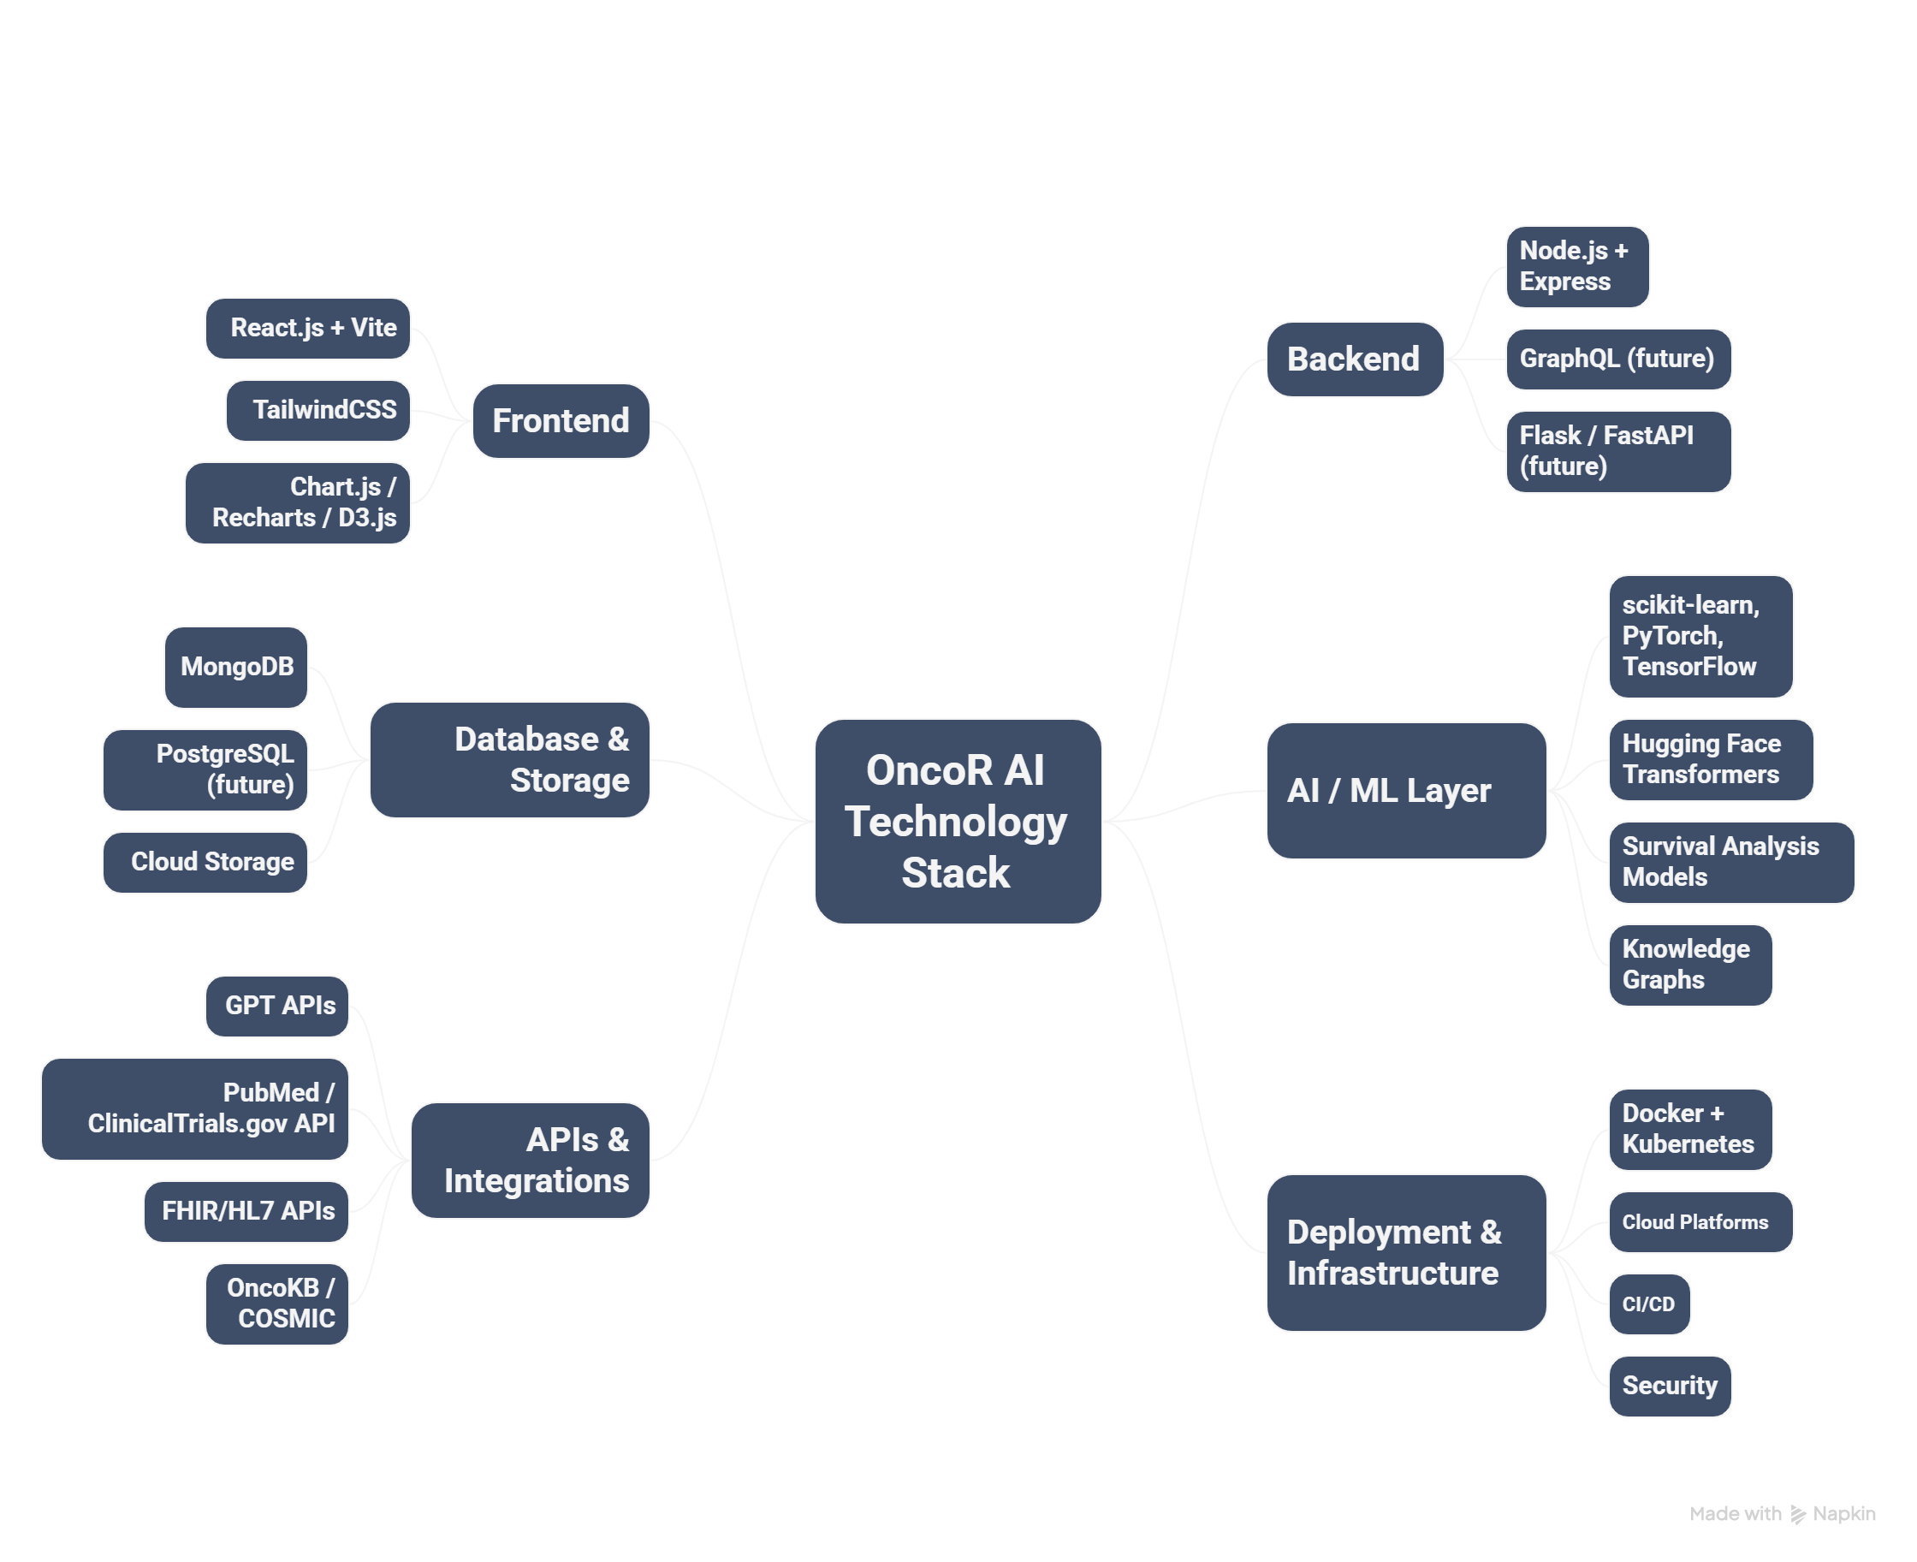
Technology Stack:

Slide 6
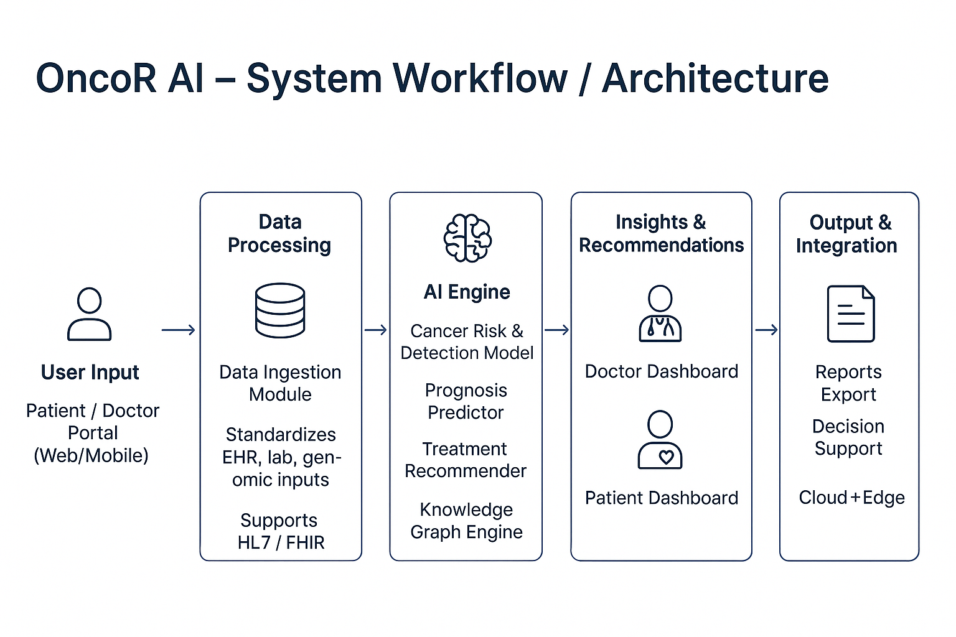

Slide 7
Transformative Features & Innovations
Multi-Modal Cancer Intelligence
Combines imaging, genomics, pathology & patient history into one AI model.
Personalized Treatment Pathways
Tailors therapy recommendations to each patient’s unique genetic + clinical profile.
Survivability Forecasts
Provides transparent, probability-based 1/5/10-year outcomes with confidence scores.
Dual Dashboards
Doctor View: Clinical depth with trial links & comparisons. Patient View: Simple, visual, easy-to-understand explanations.
Global Knowledge Integration
Continuously updates with latest research, clinical trials, drug approvals.
Seamless Hospital Integration
Connects with EHRs via FHIR/HL7 standards for real-time data flow..

Slide 8
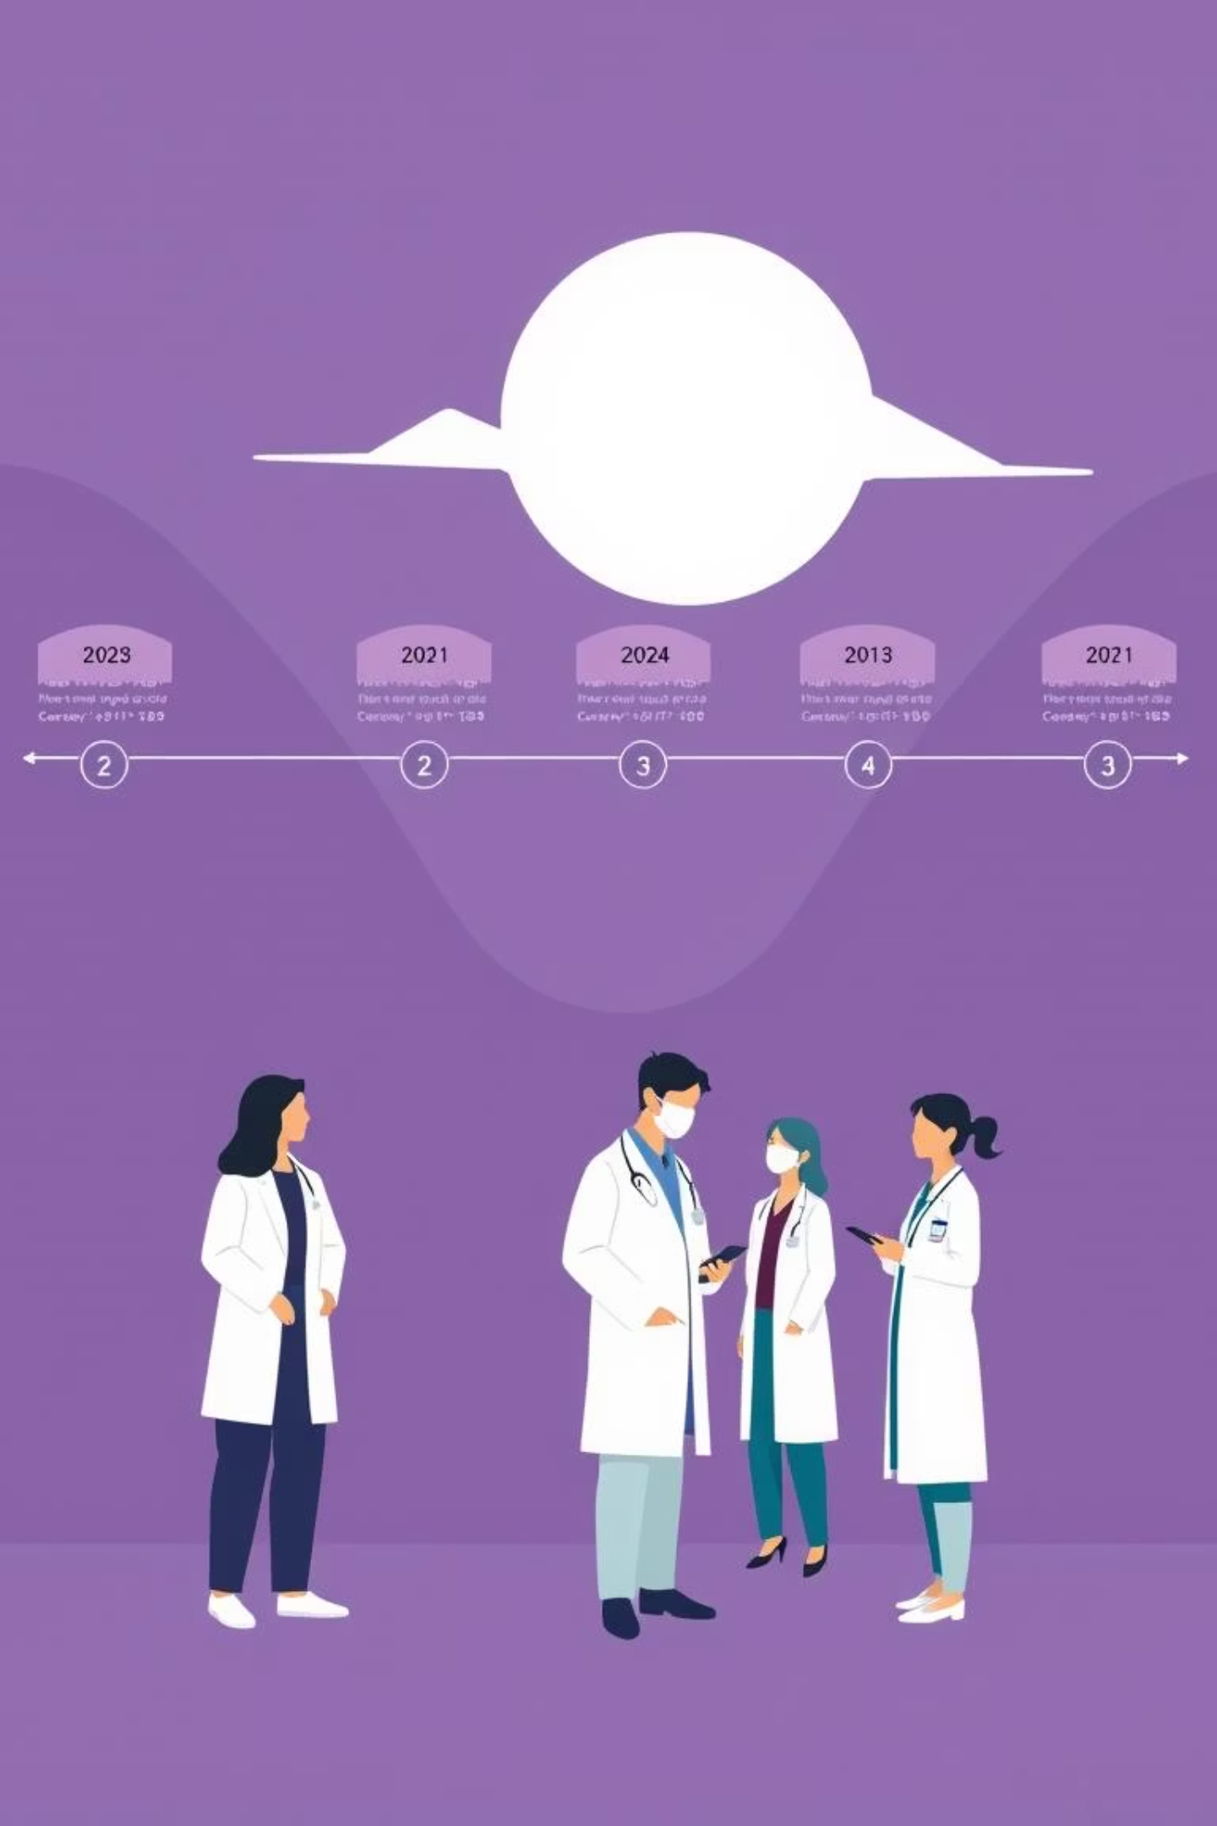
Implementation Roadmap
Our phased approach ensures robust development and successful deployment.
01
Phase 1: Idea & Prototype
Core AI model development, initial UI/UX for key features like Drug Response Predictor. (Months 1-3)
02
Phase 2: Alpha Testing & Data Integration
Integration of liquid biopsy data, internal testing with synthetic and anonymized datasets. (Months 4-6)
03
Phase 3: Clinical Pilot
Pilot program with partner institutions, full development of accurate dataset (Months 7-12)
04
Phase 4: Global Rollout & Network Expansion
Wider deployment, expansion of Global Cancer Twin Network. (Months 13-18)

Slide 9
Anticipated Challenges & Mitigation
Proactive strategies to navigate potential hurdles in development and adoption.
Data Privacy & Security
Regulatory Approval
Sensitive health data at risk of leaks or misuse.
HIPAA-compliant encryption, anonymization, differential privacy.
Must align with ICMR, HIPAA, GDPR, FDA standards.
Engage with FDA/EMA early, conduct phased clinical trials, and ensure clear documentation.
Clinical Integration & Validation
Hospitals use diverse EMR/EHR systems (compatibility issues). Use FHIR/HL7 for seamless interoperability.
AI models must be validated on real-world oncology datasets. Start with 1–2 hospitals for phased clinical validation.
Algorithm Bias
Utilize diverse training datasets, apply Explainable AI (XAI) techniques, and ensure continuous validation.
Our team is equipped to address these challenges with strategic planning and expert collaboration.

Slide 10

OncoAI: Impact, Scalability & The Future
Key Benefits
For Patients → Earlier detection, personalized treatment guidance,
clear survivability insights.
For Doctors → AI co-pilot for faster, evidence-based decisions.
For Healthcare Systems → Optimized resource allocation,
reduced diagnostic delays.
For Research & Policy → Aggregated insights for clinical trials &
public health planning
Scalability
Cloud-first architecture → Deployable in both top hospitals and rural clinics.
Modular AI engine → Can scale from single-cancer support to multi-cancer coverage.
Global adaptability → Expand beyond India with localized datasets & guidelines.
Adaptability
Multilingual support → Patients understand insights in
regional languages.
Interoperability → Seamless integration with hospital EHRs (FHIR/HL7).
Customizable dashboards → Doctor mode vs Patient mode.
OncoAI is a self-learning cancer knowledge engine, empowering doctors and accelerating cures worldwide. Join us to revolutionize the fight against cancer.

